Slide 1
Programming in the Small
Aim: to remind you how to read/write programs in Ada 95, Java and ANSI C
Practicals will be in Ada 95
For exams, you should be able to sketch solutions to problems in the three languages. However, we will not expect programs to be syntactically correct!
We will expect a higher literacy in Ada 95
We will also consider aspect of Modula-1 (for device driving) and occam2 (for its pure message-based IPC facility).

Slide 2
Fortran Example
Loop to label 20, iterating I from 1 to 100
DO 20 I = 1, 100
On the U.S. Viking Venus Probe, a programmer wrote
DO 20 I = 1. 100
The compiler interpreted this as an assignment statement and ignored the spaces
DO20I = 1.100
Variables need not be declared in Fortran, and those beginning with D are assumed to be of type real. 1.100 is a real literal!

Slide 3
An Overview of Ada
An Ada program consists of one or more program units:
  a subprogram (procedure or function) — can be generic
  a package (possibly generic) — used for encapsulation and modularity
  a task — used for concurrency
  a protected unit — a data-oriented synchronisation mechanism
Library units: package, subprogram
Subunits: subprogram, package, task, protected unit

Slide 4
Blocks
Ada is a block-structured language
declare
-- definitions of types, objects,
-- subprograms etc.
begin
-- sequence of statements
exception
-- exception handlers
end;
A block can be placed anywhere a statement can be placed

Slide 5
Points about Blocks
objects declared in a block may only be used in that block (scope)
any statement in the sequence of statement may itself be a block
exception handlers can be used to trap errors arising out of the execution of the sequence of statements (they may be omitted)

Slide 6
Example
function Largest(X : Vector) return Integer is
Max : Integer := 0;
begin
for I in X’Range loop
if X(I) > Max then
Max := X(I);
end if;
end loop;
return Max;
end Largest;
’Range is an attribute and = ’First - ’Last
What is wrong with this example?

Slide 7
The C Language
Is sequential
Main structuring units are functions (although files can be used to aid separate compilation)
Block structured (called compound statements)
{
< declarative part >
< sequence of statement >
}
Declarative part cannot contain functions
Sequence of statements can contain compound statement

Slide 8
C Example
int largest(vector X, int len)
{
int max = 0;
int i;
for (i = 0; i < len; i++) {
// bounds start at 0
if(X[i] > max) max = X[i];
}
return max;
}
Assignment statement is =
Equality is = =
Not so type secure as Ada. Typedefs are
synonyms for types not derived types.
However, the insecurities in C are well
known.

Slide 9
An Overview of Java
A class-based language
Programming in the small component is similar to C but without explicit pointer values
More type secure than C
As with Ada, Java can have exception handler at the end of a block (but only if the block is a try block)
Functions can only be declared in the context of a class

Slide 10
A Java Example
class SomeArrayManipulationClass
{
public int largest(vector X)
{
int max = 0;
int i;
for (i = 0; i < X.length; i++) {
// bounds start at 0
// length is an instance variable of array objects
if(X[i] > max) max = X[i];
}
return max;
}
}
All arrays are objects

Slide 11
Java and Reference Types
All objects in Java are represented as reference values
Comparing two objects will compare their references not their values:
  Node Ref1 = new Node();
  Node Ref2 = new Node();
  . . .
  if(Ref1 == Ref2) { . . . }
will compare the locations of the objects not their values; it is necessary to implement a compareTo method
A similar situation occurs with object assignment; it is necessary to provide a clone method

Slide 12
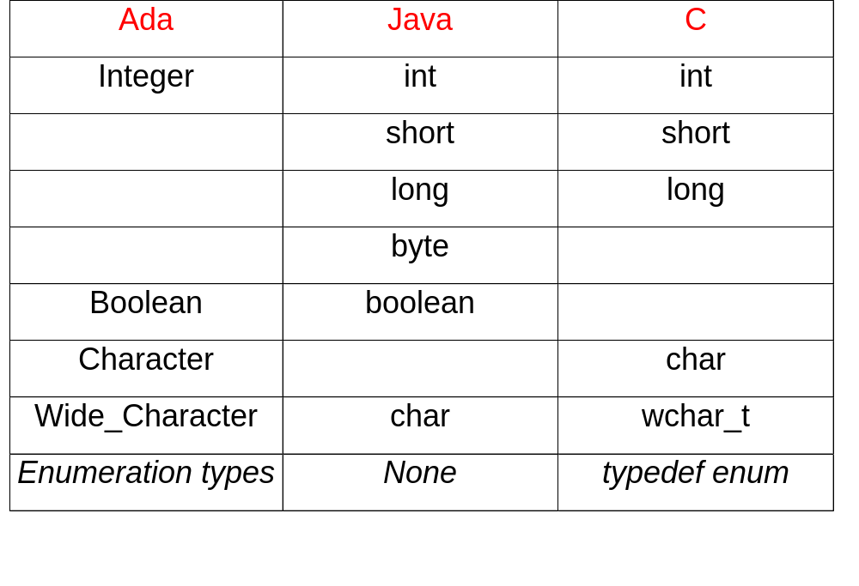
Discrete Types

